Slide 1
Server-side Web Development
Web Applications

Slide 2
HTTP Review
HTTP Clients
  Web Browsers
  Other Programs/services (Web Services)
  CLI (command line interface)
  …
HTTP Servers
  Apache Tomcat
  Microsoft IIS
  Jetty (Java Web Server)
  …

Slide 3
HTTP Requests and Responses
Clients send a HTTP request to the server
The Server sends a response back to the client
A stateless protocol – the server does not maintain any state about the client
HTTP1.1 provides support for persistent connections
Socket connections are kept open for subsequent request from the client (for image files for example)

Slide 4
URIs and URLs
Requests are for resources identified by URL or URI
URI – Uniform Resource Identifier
  Scheme:[//authority]path[?query][#fragment]
URN – Uniform Resource Name
  urn:isbn:0451450523
URL – Uniform Resource Locator
  Popular schemes: http, https, ftp, mailto, file, data, irc
  Example: http://en.wikipedia.org/wiki/Donald

Slide 5
Requesting a Resource
To obtain the resource:
  http://en.wikipedia.org/wiki/Donald
Make a TCP/IP connection on port 80 to
  http://en.wikipedia.org/
Send a request for wiki/Donald
  GET wiki/Donald HTTP/1.1

Slide 6
HTTP Methods
GET (links and some forms)
  Strictly speaking, when no changes are made on the server
  Query from a form for example
POST (forms)
  When data is stored on the server
HEAD
  Just get header information about a resource
PUT
  Upload a resource to the server

Slide 7
HTTP Methods (continued)
DELETE
  Delete a resource
TRACE
  Trace the message through Proxy Servers to the Server. The body of the response will contain the actual request the server received
OPTIONS
  Determines what methods are available on the server

Slide 8
HTTP Requests
Request Line
  GET index.jsp HTTP/1.1
  POST myApp/book/update HTTP/1.1
Headers (Zero or more header fields followed by CRLF (carriage return line feed)
  Content-Type: text/plain
  Content-length: 19
Empty Line with CRLF (Indicates end of header fields)
Optional Body
  GET has none

Slide 9
HTTP Responses
Status Line
  HTTP/1.1 200 K
Headers (Zero or more header fields followed by CRLF)
  Content-type: text/plain
  Content-length: 19
Empty Line with CRLF (Indicates end of header fields)
Optional Body
  Usually the content (HTML/Image etc.)

Slide 10
HTTP Response Codes
Broken into families/range of codes
  100-101 Informational
  200-206 Successful
  300-305 Redirection
  400-415 Client Error
  500-505 Server Error

Slide 11
HTTP Response Codes (continued)
Code Meaning
100 Continue
101 Switching Protocols
200 OK
201 Created
202 Accepted
204 No content
205 Reset Content

Slide 12
HTTP Response Codes (continued)
Code Meaning
206 Partial Content
300 Multiple Choices
301 Moved permanently
302 Moved temporarily
303 See Other
304 Not modified
305 Use Proxy

Slide 13
HTTP Response Codes (continued)
Code Meaning
306 Unused/Reserved
307 Moved temporarily

Slide 14
HTTP Response Codes (continued)
Total of 17 different 4XX codes.
(see https://www.tutorialspoint.com/http/http_status_codes.htm) for full list
Code Meaning
400 Bad request
401 Unauthorized
403 Forbidden
404 Not found

Slide 15
HTTP Response Codes (continued)
Code Meaning
500 Internal server error
501 Not implemented
502 Bad gateway
503 Service unavailable
504 Gateway Timeout
505 HTTP Version not supported

Slide 16
HTTP Request Parameters
A list of name value pairs, separated by an &.
If originating from a FORM, known as a form data set.
If used with a GET request, the parameters are appended to the URI.
If used with a POST request, the parameters are put in the body of the request.

Slide 17
HTTP GET - Example
Request
  GET /myApp/insert?name=paul&address=Athlone
Header Fields
User-agent:Chrome/3.0.195.38
Host:Host
Accept:application/xml,application/xhtml+xml,text/html;q=0.9,
text/plain;q=0.8,image/png,*/*;q=0.5

Slide 18
HTTP POST - Example
Request Line
POST /myApp/insert
Header Fields
User-agent:Chrome/3.0.195.38
Host:Host
Accept:application/xml,application/xhtml+xml,text/html;q=0.9,
text/plain;q=0.8,image/png,*/*;q=0.5
Content-length:25
Empty Line
Body
name=paul&address=athlone

Slide 19
Web Resources
Static Web pages written in HTML.
The Web server reads the HTML file off the disk and sends it to the client (Web Browser).
Dynamic Page generated by a Web Application.
Often we don′t know (or care).

Slide 20
Web Application Frameworks
Java (lots)
PHP
C# and .net
Ruby (on Rails)
Groovy (& Grails)
Python (Django)

Slide 21
Web Application Frameworks - Java
Java Servlets is the basis for most Java based frameworks.
Java Server Pages (JSP) is often used with Servlets.
Apache Struts, JSF, GWT
Spring MVC (Model View Controller), Roo
Groovy and Grails
Java based as Groovy is completely interoperable with Java.
Grails based on the Spring Framework.

Slide 22
Web Servers – Java Support
Most Web servers are now also Servlet/JSP containers.
This means that they can:
accept GET and POST requests
start the appropriate Java servlet
pass data to the servlet for processing
accept HTML back from the servlet
pass it back to the client
(JSPs are compiled (translated) into Servlets.)

Slide 23
Terms – Web Server
Web Server
serve up Web pages (Apache)
most handle Java based Web Applications as well (Apache Tomcat)
became know as Application Servers

Slide 24
Terms – Application Server
Application Servers
  Handle Java based Web Applications
Also started to provide much more, such as:
  transaction support
  security support
  range of other services
JBoss, Glassfish, WebLogic, WebSphere

Slide 25
Terms - Container
We can think of the Application Server as a container which can contain:
  Web Applications
  Enterprise Java Beans (EJB) components
The Application Server can accept requests and pass them to the contained Web Application.
Servlet Container, EJB container, -most Application servers are both.

Slide 26
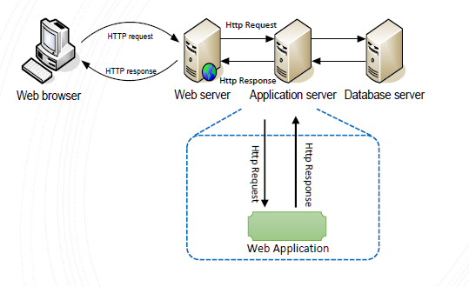
Application Server as a Container

Slide 27
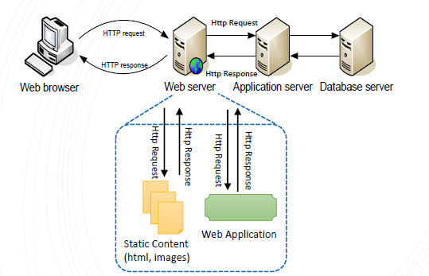
Alternatively – Web Application

Slide 28
Typical Web Applications in Java/Groovy
Some HTML pages.
Forms.
Form Processing Agents
Either Java Servlets and/or Java Server Pages (JSP) to process form data.
Or built on top of Servlets and developed using some Web Application Framework such as Grails.
Database backend.

Slide 29
J2EE Servlet Specification
Part of the J2EE specification
Java Enterprise Edition.
Specifies how a Web Application is deployed to a Web/Application Server such as Tomcat.
Typically the Application Server is going to expect resource files to be in a certain location.
So when we develop our Web applications, we are going to use a quite specific directory structure for that Web Application.

Slide 30
WAR File
Packaging for a Web Application.
WAR –Web Archive (.war extension)
Like a JAR file, it is just a zipped folder.
Normally when a Web application is deployed, it is first converted to a WAR file.
Then it is deployed to a Web Container, that is it is copied to some specific location.
[For development and testing, WAR files would typically not be generated.]

Slide 31
Server Side Web Development
Java based Web Application Frameworks are all based on Java Servlets
We will look at Java Servlets and JSP (Java Server Pages)

Slide 32
MVC (Model View Controller) Architecture
This architecture is now widely used for Web Development
We will adopt this architecture as much as possible with Servlets and JSP
Other Web Development Frameworks (Grails) force us into using it

Slide 33
MVC Architecture
Model (short for domain model)
  The classes in your application, modelling objects in the real world (application domain)
View
  The part of your application that generates the pages that the user sees
Controller
  Receives the HTTP requests and carries out certain actions

Slide 34
Web Development Complexity
Languages
Java (Groovy)
View technology – JSP (GSP)
HTML
CSS
javascript
javascript libraries
Configuration files (XML/DSLs)
The individual files may be simple enough, but there is complexity in the relationships between them

Slide 35
References
http://www.w3schools.com/html/default.asp
http://www.tutorialspoint.com/jsp/index.htm
http://www.tutorialspoint.com/jsp/jsp_standard_tag_library.htm
http://courses.coreservlets.com/Course-Materials/csajsp2.html

